Slide 1


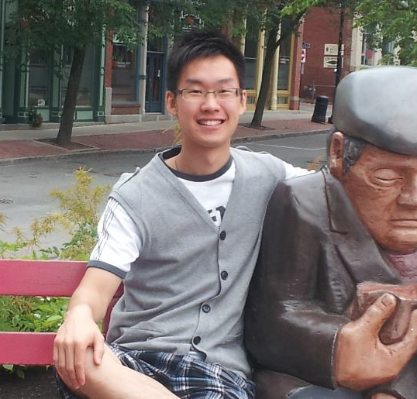
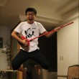
MYO Workout Monitor
Nadim, Mathieu, Cheng, Ze

Slide 2
The problem to solve

Slide 3

The Problem to Solve
Patients cannot perform exercises alone
Improper movement
Improper speed
Improper range of motion
Keeping a routine

Slide 4
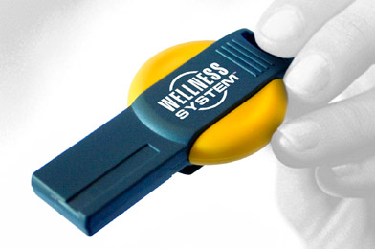
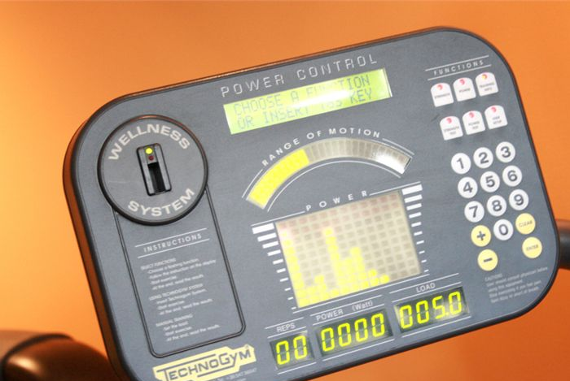
Current Solutions
Does not work with free weights
Patients need to go to gym
Costly

Slide 5
Our goal

Slide 6
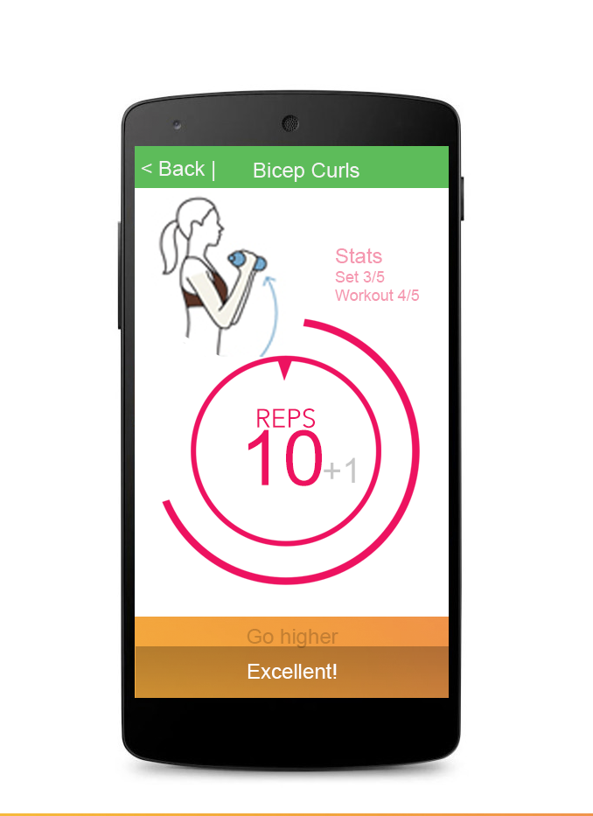
Goal
Track motion with thalmic MYO
Feedback on user’s exercise
Speed
Range of motion
Repetition counter

Slide 7
WearHacks Prototype

Slide 8
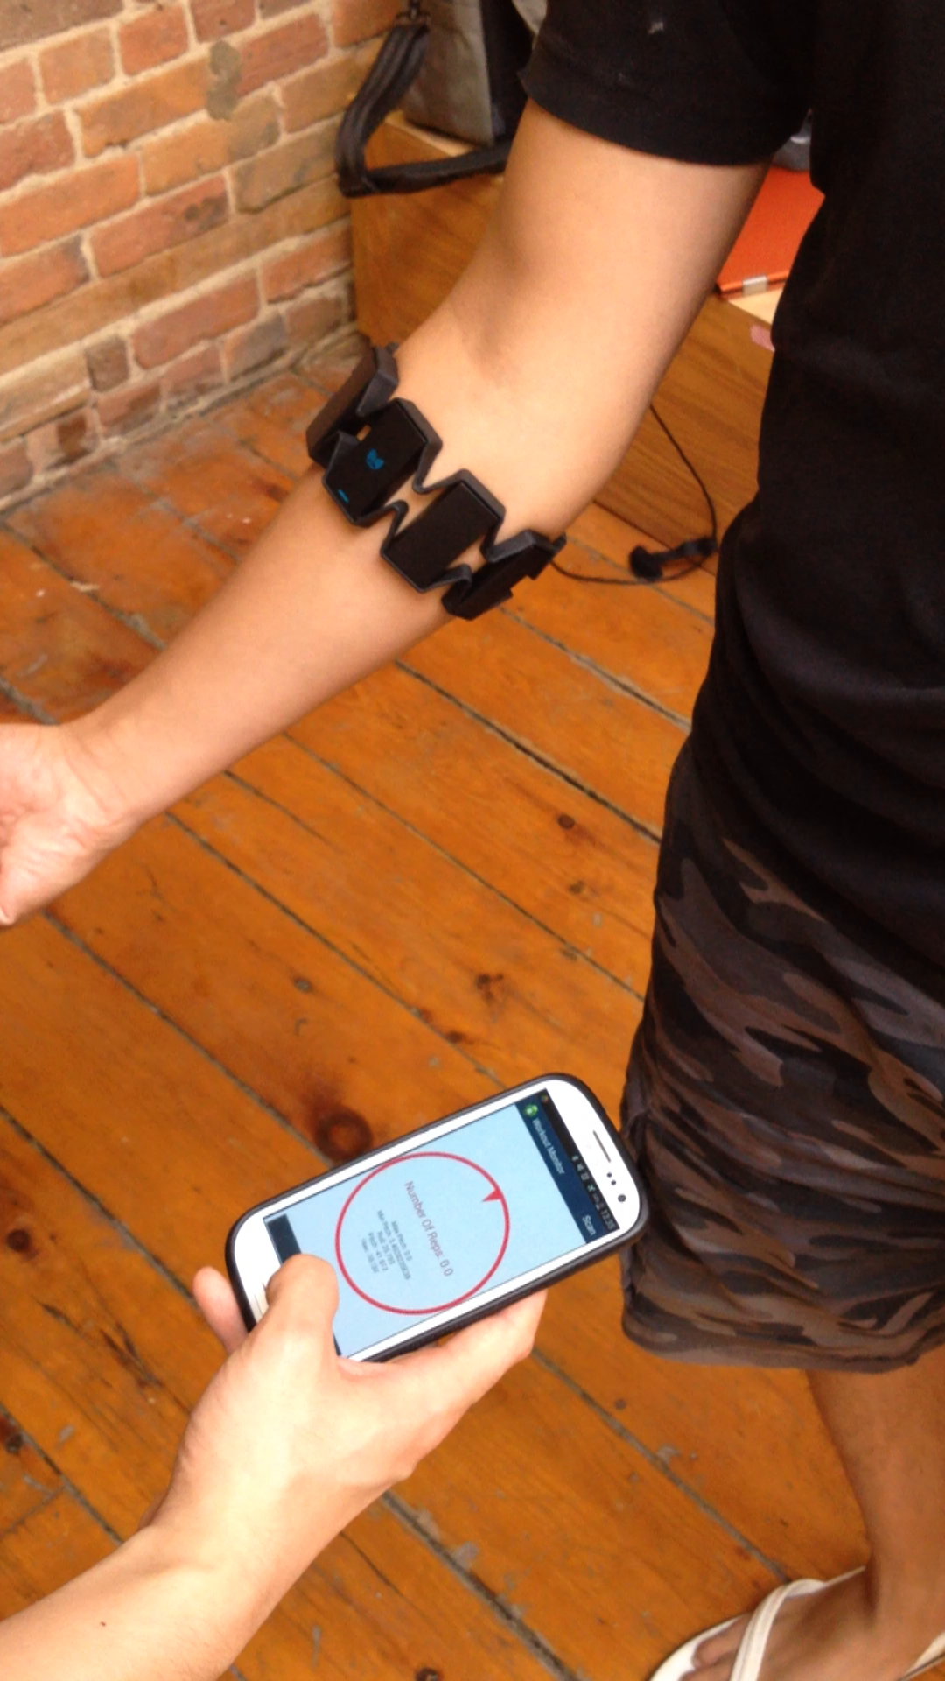
WearHacks Prototype
Record Exercise
Range of Motion
Repetition counter
Haptic feedback

Slide 9
Thank you

